Slide 1

Enhancing Mobile Network Quality Through User Feedback
Mobile network subscribers in developing countries like Cameroon expect high-quality service. However, users often experience fluctuating network speeds, dropped calls, and unavailability. This project proposes a mobile application to bridge the gap between network-centric metrics and actual user experience (QoE).
The app will collect real-time user feedback and monitor device and network performance parameters. This hybrid approach will help mobile network providers optimize performance, improve user satisfaction, and make data-driven decisions.

Slide 2
Stakeholders
Stakeholders are individuals or groups with an interest in an organization's success. Understanding stakeholders is crucial for project success. By conducting a stakeholder analysis, organizations can prioritize, tailor communication, and analyze influence.
Primary Internal Stakeholders
Primary External Stakeholders
Secondary External Stakeholders
Investors
Local Communities
Customers
Owners
First Nations Groups
Suppliers and Vendors
Boards of Directors
Lenders
Media Groups
Company Leadership
Regulators and Government Bodies
Trade Unions and Industry Bodies
Employees
Interest Groups

Slide 3




Stakeholders Involved in This Project
Mobile Network Subscribers (End Users)
Mobile Network Operators (e.g., MTN, Orange)
Core target audience who will install and use the app, providing subjective feedback and allowing data collection. User adoption depends on usability, transparency, and data privacy.
Responsible for delivering mobile services, gaining insights into user QoE, optimizing network infrastructure, and improving customer satisfaction. Collaboration and transparency are critical.
Telecommunications Regulatory Bodies
Oversee mobile service standards, protect consumer rights, ensure project alignment with laws, and support evidence-based policies. Their endorsement boosts public trust.
Primary stakeholders include mobile network subscribers and operators. Secondary stakeholders include telecommunications regulatory bodies, mobile app developers, researchers, and privacy advocates.

Slide 4





Requirement Gathering Techniques
Requirement gathering is a foundational process in software engineering. Effective requirement gathering ensures the final product meets user needs, minimizes rework, and identifies functional and non-functional requirements.
Interviews
Direct communication with stakeholders to gather expectations and needs.
Surveys/Questionnaires
Distributing pre-designed questions to a large group of stakeholders.
Workshops
Group discussions to extract, discuss, and prioritize requirements.
Observation
Observing users as they perform tasks to gather insights.

Slide 5
Requirement Gathering Techniques Used
Surveys – User Experience Questionnaire
Interviews – MTN Staff (UB Office)
Collected quantitative and qualitative data from mobile subscribers, including demographics, usage behavior, QoE ratings, and interest in the app. Identified common user issues and willingness to engage with a solution.
Conducted qualitative interviews with MTN personnel to understand current monitoring techniques, feedback channels, key metrics, challenges, and concerns about integration. Revealed manual methods are time-consuming.
In this requirement gathering phase, we mainly used brainstorming, interviews, and surveys since they best suited our project type, resources available, and stakeholders involved.

Slide 6

Data Gathering Methods Used
Surveys provided scalable and structured data collection. Interviews were semi-structured and provided context to the survey data. Document analysis helped refine the requirements and priorities for a monitoring system.
Online Survey
A structured questionnaire was distributed digitally to mobile network users in Cameroon, covering age, provider, data usage, service satisfaction, and privacy concerns. Total responses: 47.
Field Interviews at MTN Office, UB
On-site interviews were conducted with commercial workers at the MTN Office in the University of Buea (UB) to gain insights into recurring complaints and internal response strategies.

Slide 7
Data Cleaning Process
Data cleaning is a critical preprocessing step in data analysis. It ensures that the dataset is accurate, consistent,
and usable for generating insights and building reliable software requirements.
Filtering
Removed duplicates, incomplete entries, and inconsistent values.
Categorizing
Categorized open-ended responses into themes.
Excluding
Excluded redundant/irrelevant statements from interview responses.
Visualising
Representing responses on charts to see trends.

Slide 8
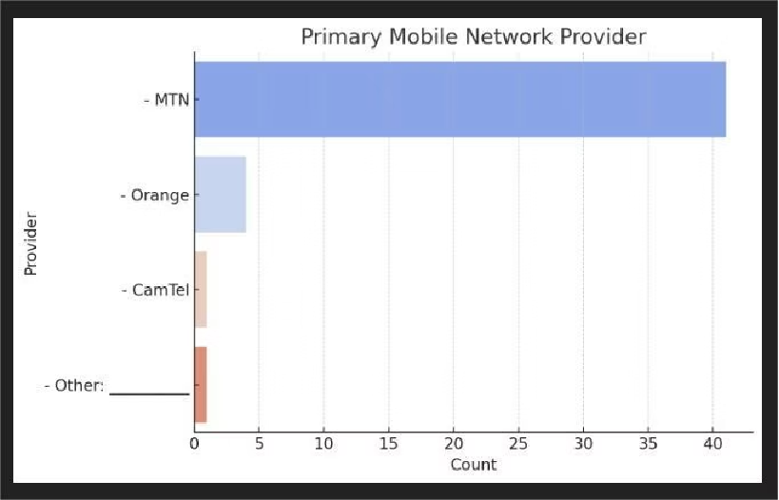
Visual 1

Slide 9
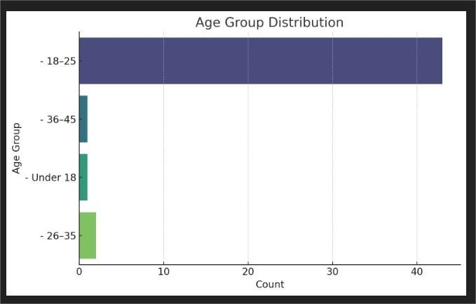
Visual 2

Slide 10
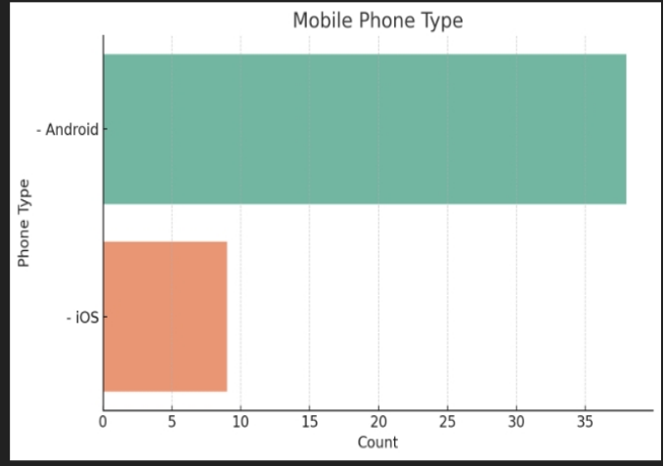
Visual 3

Slide 11
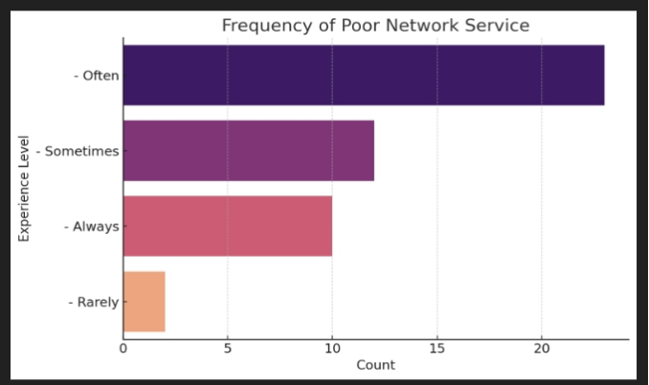
Visual 4

Slide 12
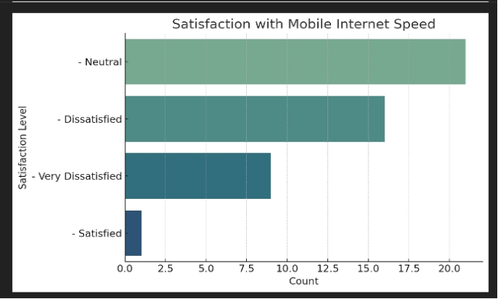
Visual 5

Slide 13
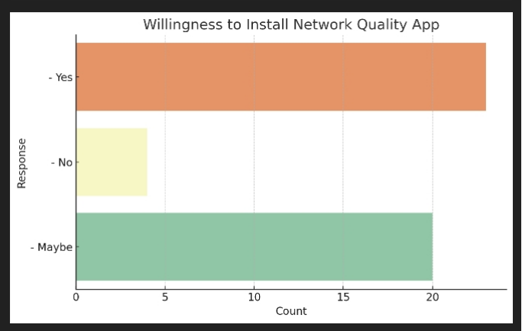
Visual 6

Slide 14
Functional and Non-Functional Requirements
Functional requirements are the features and functions the system must perform. Non-functional requirements define how the system should behave rather than what it does.
Functional Requirements
Non-Functional Requirements
Real-Time Network Speed Monitoring
Performance
Network Quality Alerts
Reliability
User Feedback Submission
Scalability
Service History and Logs
Security
Privacy and Data Control Settings
Usability
Support Integration
Maintainability
Multilingual Interface
Compatibility
Localization Support

Slide 15








Addressing User Reluctance
Privacy Concerns
Battery Consumption
Transparent policies, granular permissions, anonymization, and real-time control.
Optimized code, user-selectable modes, and resource-aware scheduling.
Notification Fatigue
Trust and Awareness
Smart triggers, customizable preferences, and minimal UI disruptions.
Educational onboarding, brand partnerships, and in-app support.
Understanding user reluctance is crucial to ensuring adoption and continuous engagement with the proposed mobile app. Key concerns include privacy, battery consumption, notification fatigue, trust, and resistance to change.

Slide 16

Conclusion
The data cleaning process ensured that the survey data was reliable, consistent, and ready for use in deriving software requirements. By addressing formatting inconsistencies, dealing with embedded delimiters, and validating data types, we built a strong foundation for requirement prioritization and stakeholder validation.
This cleaned dataset is now a dependable source for modeling user behavior, informing feature development, and aligning mobile network improvements with real-world expectations.

